Slide 1
Year 6 Residential Visit 2024

Slide 2

Bawdsey Manor, Suffolk
A Grade II listed manor with spectacular views, beautiful beaches and 140 acres of gardens and woodland.
All activity sessions are led by well trained, enthusiastic instructors.
A popular choice with Primary Schools from London and the surrounding areas
https://www.pgl.co.uk/en-gb/school-trips/resources/parent-guide/about

Slide 3
Timings ….
Dates: Monday 24th June – Friday 28th June
Departure time from St Helen’s – 1:00 pm (children to arrive in school by 10:30 please)
Everyone to bring a packed lunch and a snack. We will eat an early lunch then have a snack once we arrive.
Arrival time at Bawdsey Manor – estimated to be 3:45 pm
Departure time from Bawdsey Manor – 2:00 pm
Arrival time at St Helen’s - estimated to be 4:45 pm
(depending on the dreaded Dartford Crossing)

Slide 4
What to pack….
IT IS IMPORTANT TO NAME ALL BELONGINGS.
Things you will need:
One piece of luggage (that they can carry or pull along!)
Freshly laundered sleeping bag, Pillow and Pillow case (single duvet in cover if a sleeping bag not available)
A drinks bottle
Rucksack (small to carry their drink bottle and waterproof jacket)
Toiletries – deodorant, shower gel, toothpaste, toothbrush, flannel/scrunchie but NO AEROSOLS
Bin bag for dirty clothes
2 towels
Sun cream/sun hat/hair ties
NO JEWELLERY (including watches), NO PHONES, NO ELECTRONICS, NO CAMERAS
GIRLS MUST HAVE LONG HAIR TIED BACK FOR ACTIVITIES
Please NO SWEETS/SNACKS ‘for the room’.

Slide 5
Clothing to pack ….
All clothing should be old
Underwear (x 4 plus spares in case they get wet)
Pyjamas
Two pairs of trainers (closed in shoes)
Socks (x 4 plus spares incase they get wet)
Slippers/flip-flops
Short sleeve t-shirts (x 4)
Fleece tops/hoodies (x 4)
Jogging bottoms/tracksuit bottoms/cargo pants/leggings (NO DENIM) (x 4 incase they get wet)
Long sleeve t-shirts ( x 3)
Waterproof jacket
Shorts (mid thigh length NOT ‘HOT PANTS’) (x 3 incase they get wet)
One piece swimsuit/swimshorts x 2

Slide 6
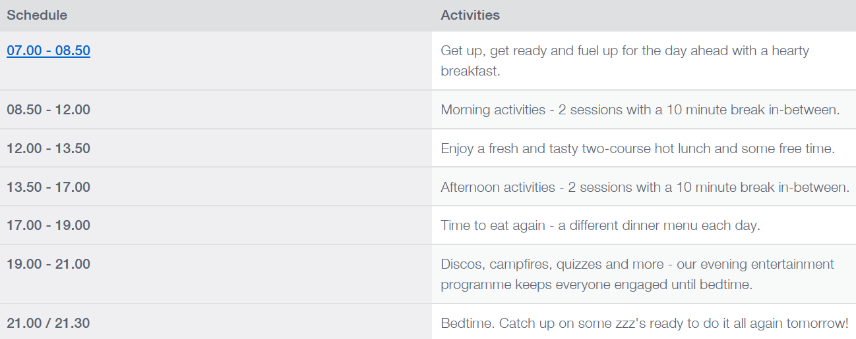
Sample Day ….

Slide 7
Activities….
These could include:
Raft building
Giant Swing
Archery
Zip Wire
Jacobs Ladder
Sensory trail
Rifle Shooting
Buggy building
(Most of these activities require the children to have long sleeves and long trousers)

Slide 8
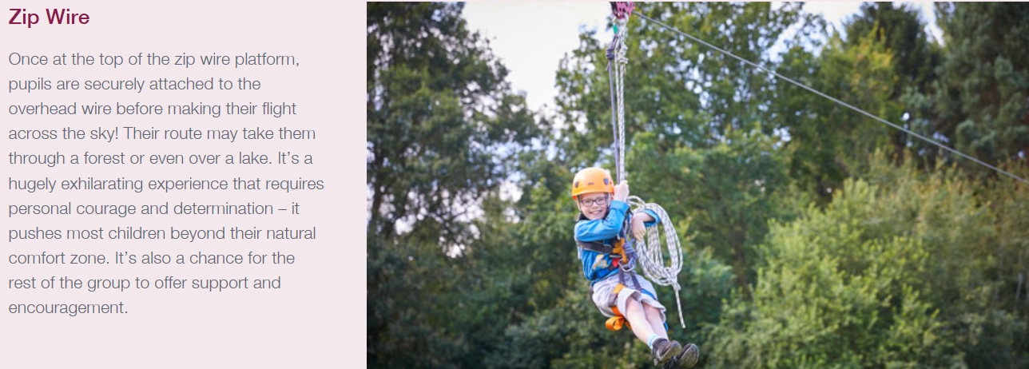
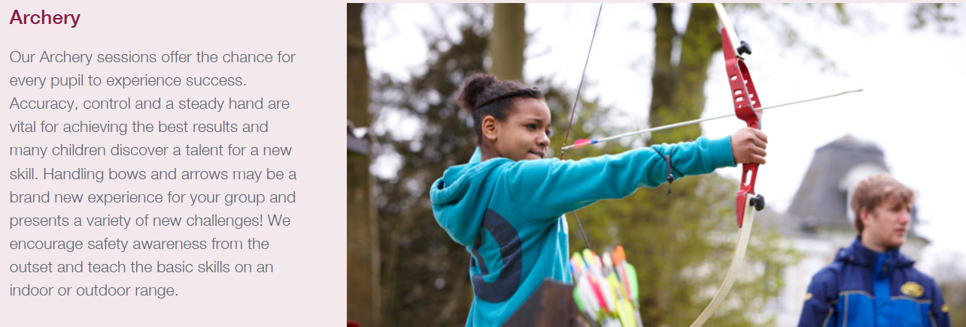

Slide 9
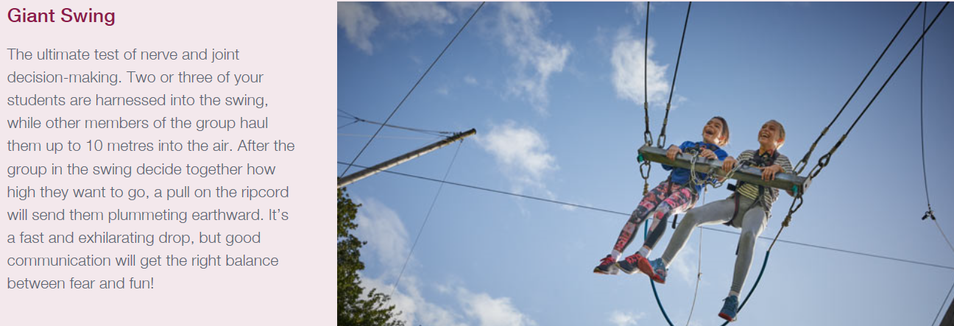
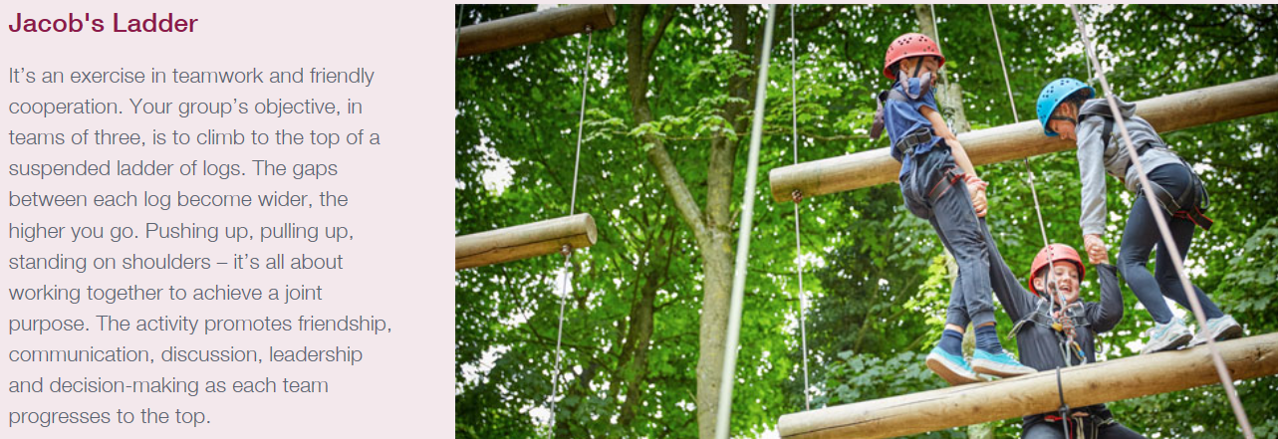

Slide 10
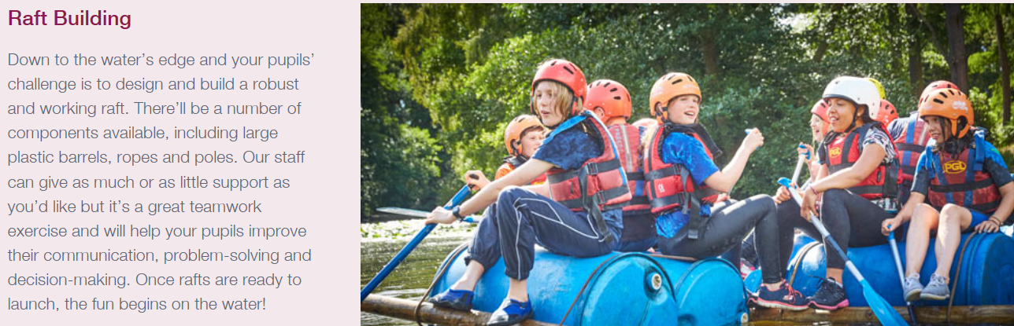
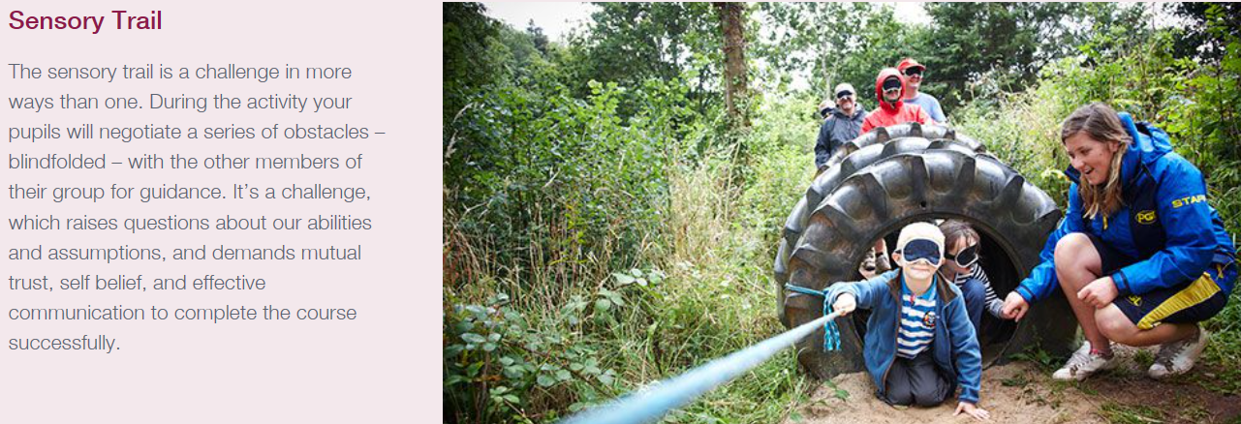

Slide 11
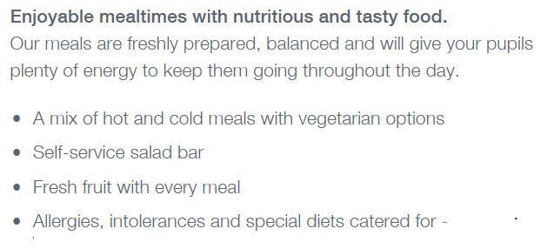
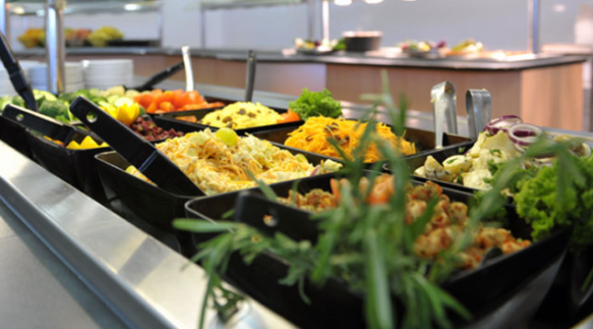
Food ….

Slide 12

Fresh fruit is available at every meal.
Unlimited salad.
Unlimited water or squash.

Slide 13
Medication…
All doctors prescribed medication needs to be handed to school staff on the morning of the residential named with clear dosage marked.
All other medication (hay fever tablets etc) also needs to be clearly labelled with name and handed in to staff.
Medication will be administered mornings/evenings by group leaders to pupils (inhalers/epi-pens carried by group leader at all times).

Slide 14
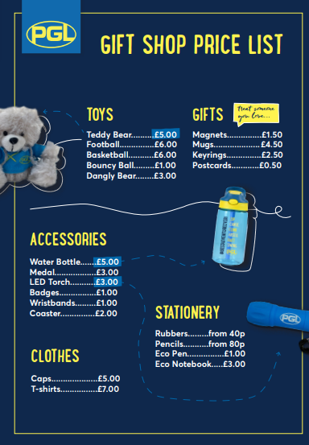
Gift Shop
Children are able to visit the gift shop at Bawdsey Manor. Here is a price list.
A maximum of £10 spending money in a named envelope for each child.
Please make sure money is in a zipped wallet or purse so it can be kept safe.

Slide 15
Instagram….
The account you need to search for is secured and PRIVATE. You need to search for: sthelensresidential.24 (Please take note of the dot before 24)
A letter is attached to this pack for you to complete your own Instagram account details on (your @name) and once we receive this, only then we will allow you to follow our account. ONLY 2 accounts per child as this is strictly for PARENTS not siblings, grandparents or any other relatives or friends.
Any photographs from this account are NOT to be posted on ANY social media sites as this is against school policy to protect individuals privacy and safety.

Slide 16
Any questions?

