Slide 2
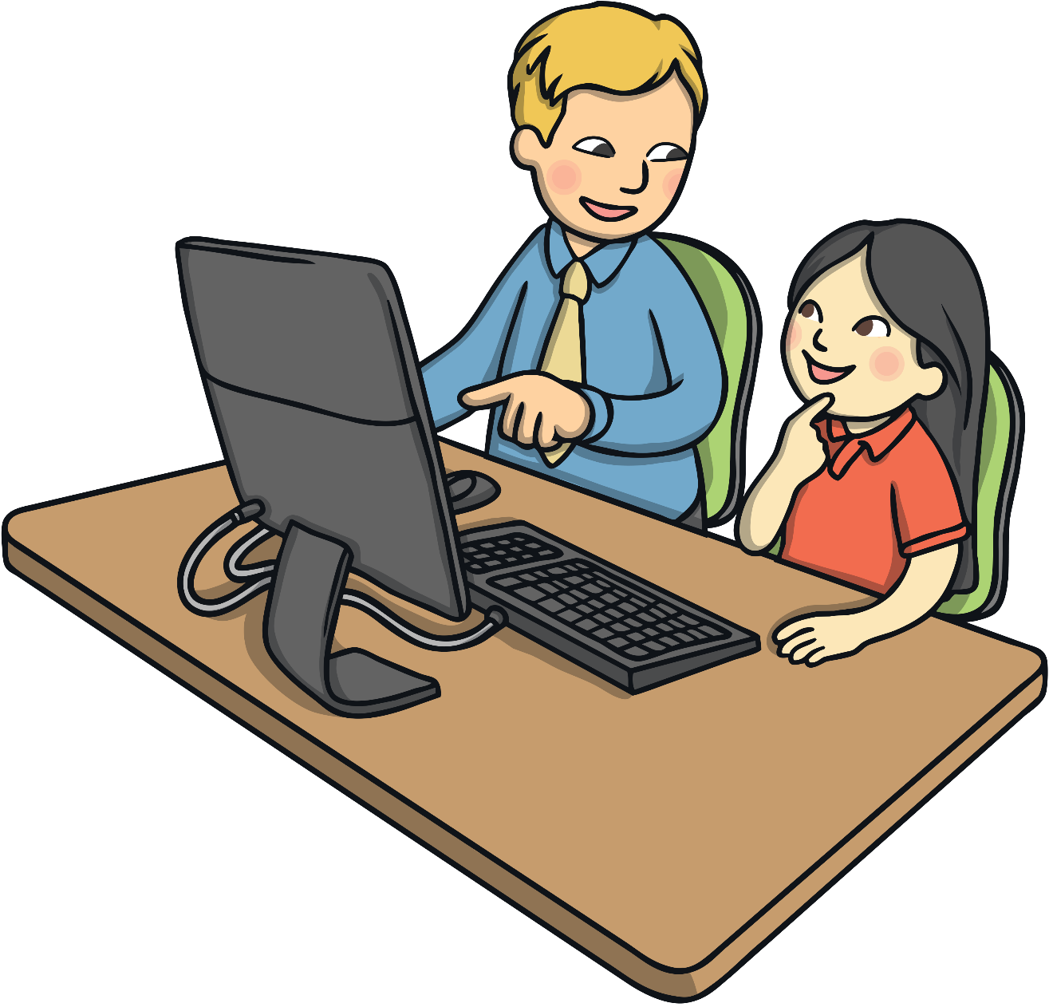
Safer Internet Day
Tuesday 11th February 2025
The theme for Safer Internet Day 2025 is ‘Too good to be true? Protecting yourself and others from scams online’.

Slide 3

Going Online
Talk about it:
When do you go online? Why do you go online?
We can go online for lots of reasons, such as to:
watch TV shows
play games
watch online videos
talk to friends
find out information
complete homework
The Internet can be loads of fun!

Slide 4

But…
Who do you think owns the Internet?
Who do you think decides what can be put on to it?
Who makes sure the things on the Internet are truthful and real?
No one owns the Internet. No one decides what can be put on it.
The Internet can be used by everyone and everyone can add things to it!
Talk about it:
Trust means to be able to count on someone and know they are telling the truth. Do you think you can trust everything and everyone on the Internet?

Slide 5

What Would You Do…?
Talk to your partner about these two different situations. Tell them what you would do and explain why.
If a stranger told you that they had a free gift for you as long as you told them your name and address?

Slide 6


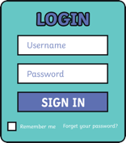
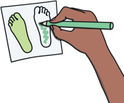



Public or Private
Talk About It: What information should you never share with people online?
favourite
book
address
address
password
password
drawings
you have
done
birthday
birthday
full
name
full
name
school
school

Slide 7

Stay Safe Online
Here are some important things to remember when you are online.
Just like in the real world, the Internet has both nice and unkind people using it.
Some people might pretend to be someone else or offer fake things to trick you into giving them money or personal information. This is called a scam.
People who try to trick others into giving them money or personal information are called scammers.
Online scams can be tricky to spot so it is important to stay alert when you are online.

Slide 8

Stay Safe Online
Remember, anyone can use and add things to the Internet. This means that we can’t always trust what we see on it.
We can’t always trust that people who want to talk to us on the Internet are trustworthy.
We can’t always trust the websites on the Internet. Some may have viruses that can stop our computers from working properly!
So, how can we spot a scam online?

Slide 9
Spotting Online Scams
Scams usually have more than one clue. If you think something might be a scam, always ask a trusted adult for help.
There are some clues that you can look for to help you spot an online scam.
S
  omething seems too good to be true. Have you won a competition that you didn't enter?
C
  ontact you weren’t expecting. Have you received a message from someone you don’t know?
A
  sking for personal information. Are you being asked to send personal information like your full name or address?
M
  entions money or trading. Is the person asking you to give them something that belongs to you or your family?

Slide 10


Can You Spot the Scam?
Talk About It: What do you think this online scam is trying to do?
The scammer is trying to trick you into sharing something that belongs to you. What clues did you spot?
They don’t say the name of your friend.
They could be someone pretending to be your friend.
GamingGirl25:
Hi. I know one of your friends at school. They said you have lots of coins. Will you trade 100 coins for my rare dragon? It will help you pass through all the levels. Trust me!
You are being asked to share something that belongs to you.
They are offering you something that could be fake.

Slide 11
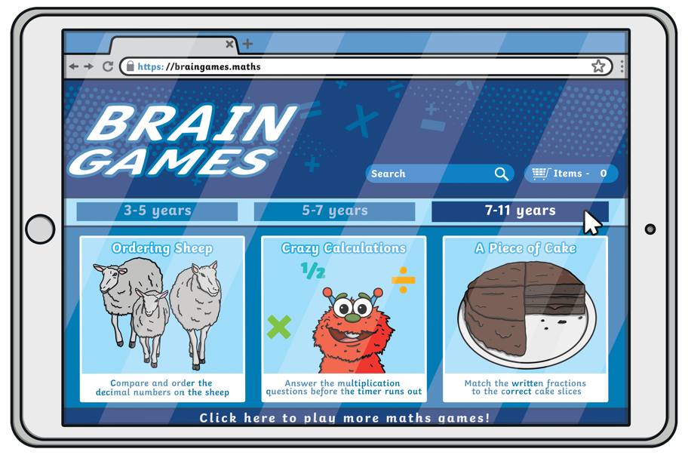

Can You Spot the Scam?
Talk About It: What do you think this online scam is trying to do?
The scammer is trying to trick you into sharing your personal information. What clues did you spot?
It doesn’t say what the competition is about.
W I N N E R!
You have won the competition!
Enter your details below to get your amazing prize.
Full Name:
Address:
Birthday:
It doesn't say what the prize is.
It is asking for a lot of personal information.

Slide 12
Remember to Be SMART
Stay Safe: Never give your name, address or passwords out to anyone online. They may say they are the same age as you but they could be lying.
Meet: Never go to meet someone you have made friends with online. If an online friend wants to see you, talk to an adult you trust. Remember that they might not be who they say they are.
Accepting: If someone sends you a photo or a file, ask a trusted adult for help. Do not open the photo or file. It could have a virus.
Reliable: Remember that you can’t trust everyone who uses the Internet. Not everyone is kind or trustworthy.
Tell: Tell a trusted adult if something online upsets you or makes you worried.

