Slide 2
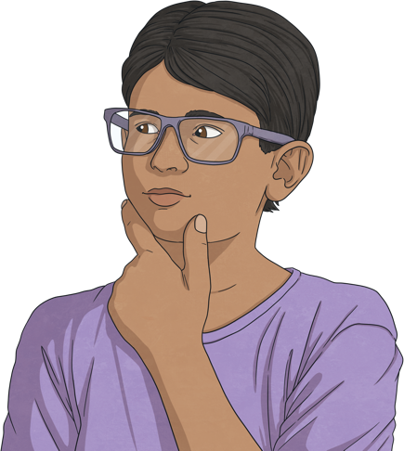
What Is a Scam?
Scams plans used to trick people into giving away their personal information, money or valuable items.
Scammers might pretend to be someone else or offer something that is not real to steal your money or personal information.
An online scam is when this is carried out over the Internet.
These online scams often start in one of the following places:
email or messaging services;
websites;
social media platforms;
gaming platforms.

Slide 3

History of Scams
There have been reported cases of scams as far back as 300 BC. A Greek sea merchant who took out a loan using his ship as collateral – something valuable that you give to someone you can’t pay back.
While delivering his ship full of corn, he planned to sink his ship so that the loan couldn’t be collected. He was caught before he could sink it.

Slide 4
Can you give any examples of any scams?

Slide 5
Online Scams?
There are so many different online scams out there, with new ones being thought of all the time. Here are just a selection:
online shopping and counterfeit goods
social media and fake profiles
fake offers, reward and prizes
fake websites and pharming
adverts and clickbait
malicious downloads and viruses

Slide 6
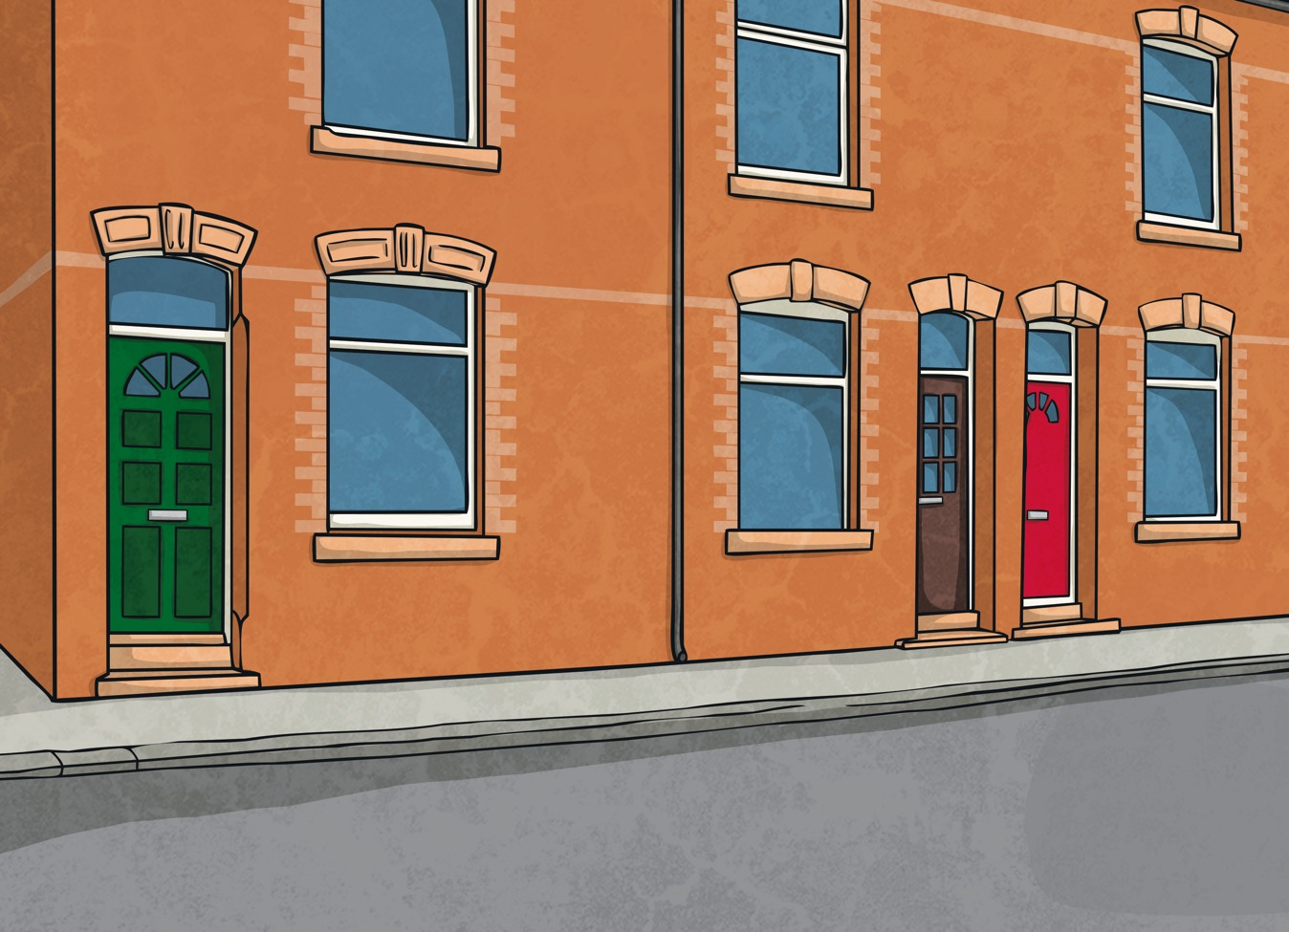

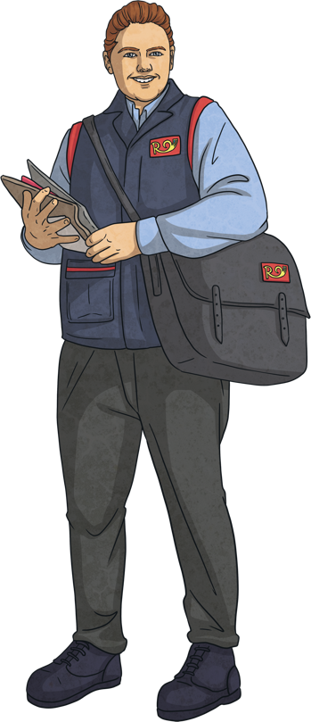
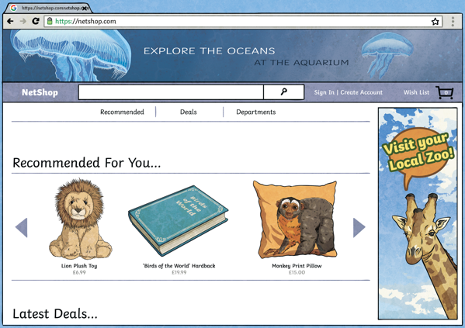

Let’s look at a few online scams that you may come across…
What might this look like in real life?
You think you are getting one thing in a sale or trade but actually you get something else.
It can also happen with adverts for apps. You like the look of the app so you buy it. However, when you open it, you have to pay extra for the bit that you liked.
Making an object look exactly like something else to trick someone into thinking they are getting the real thing.

Slide 7

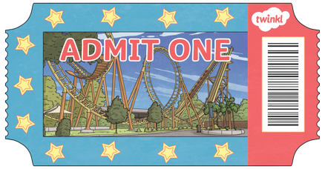
Let’s look at a few online scams that you may come across…
What might this look like in real life?
You might get an email saying “click here for free tickets to visit your favourite theme park”.
It might be a pop-up within your favourite online game or on social media that says “click here for extra credits” or “click here to get a free wallpaper”.
It could even be a message on your phone that says “congratulations you’ve won a free gift card”.
Often the messages or emails look really genuine.

Slide 8

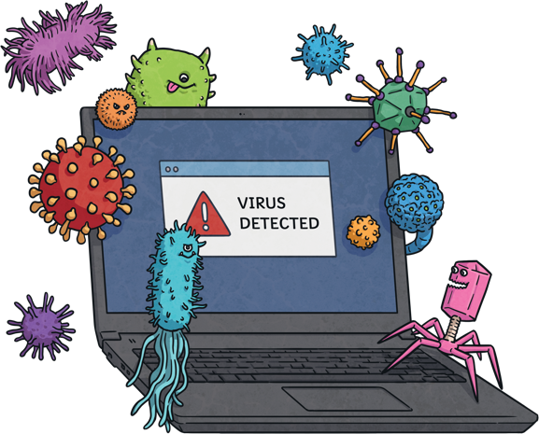
Let’s look at a few online scams that you may come across…
Sometimes scammers can convince you that your device is infected with a virus and encourage you to download software in order to fix it. This software can then infect your device for real.

Slide 9
How Can We Stay Safe Online Against Scams?
S
Sometimes scams will offer a free gift or something fabulous.
‘seems too good to be true’
C
Sometimes scams will come through in a message or email from an unknown person.
‘contact you did not expect’
A
Sometimes scams will ask for personal information.
‘asked for personal information’
M
Sometimes scams will ask you to trade something valuable or spend money on something.
‘money or trade being asked for’

Slide 10
How Can We Report Scams?
Speak to your parents
Where can people report scams?
CEOP
When older, if you're contacted by someone claiming to be from your bank, or someone asking for financial details, stop, hang up and dial 159 .
Speak to a trusted adult.

Slide 11


Future Scams
We never know what the future will bring but knowing how scams have advanced over time means we can predict some of the possible ways that scams may evolve.
Artificial Intelligence (AI) is likely to have a major impact on online scams. Creating more scams, but also preventing scams.
AI will probably make online scams more tricky to detect and also faster to make a scam happen. An email that normally would have taken half an hour to write could be created in seconds.

Slide 12
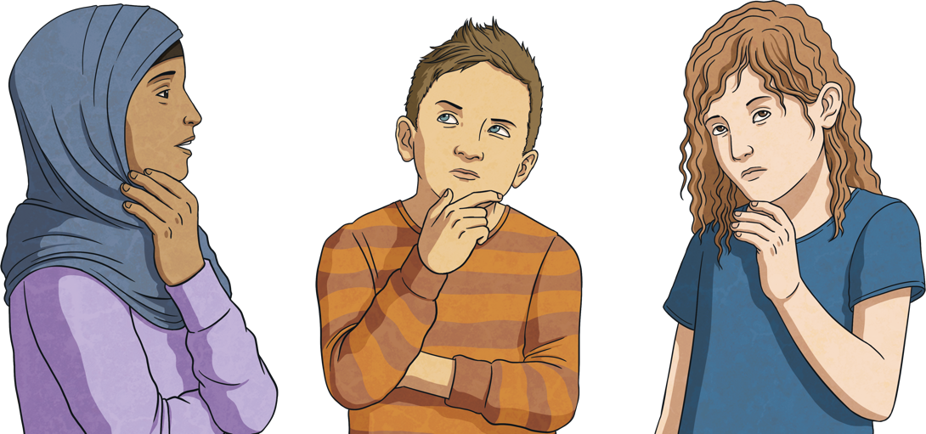
Future Scams
Often scams centre around a specific trend or platform so how technology develops and what is popular will have an impact on what scams we are likely to come across in the future.
What do you think will feature in future online scams?

Slide 13
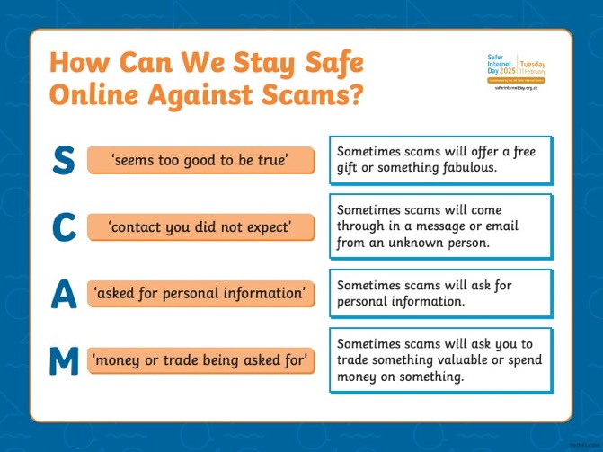
Now it’s your turn to share your understanding with others…
Task
Use what you’ve learnt to create a poster about staying safe against online scams.
Remember to include:
examples of online scams;
ways to stay safe.
What I can remember about scams:

